Slide 1

iLab 1 – Showcase Transport for NSW
Corinna Maher Mittmann

Slide 2
Overview
Part 1
Part 2

Slide 3

Merging data

Slide 4


Purpose

Slide 5
Matching Records directly assumes direct entities exist in both tables
Entity matching is inherently a classification problem
Example:

Slide 6
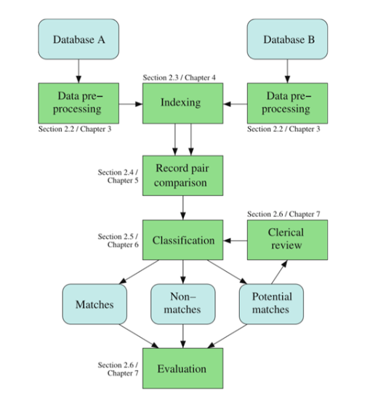
Workflow
Standardise the columns
Model and Clerical Evaluation based on
Probability Scores
Visualise, review and check for modelling errors

Slide 7
Benefits and Potential for Entity Matching Method
Potentially separate HTS participants from general users, and assess whether there are differences/biases in travel behaviour compare to all Opal data
Estimate demographic information for Opal users based on HTS matches to increase the OD coverage for modelling

Slide 8
Issues for Entity Matching
Privacy Concerns
Assumptions
that HTS members correctly recollect information about travel
Miss-matching will also have consequences on data quality
There is currently no certain validation method
Data can be simulated to train data matching but understanding the data error process can be challenging
Manual validation is the best proposed method for data matching
Manual validation requires labour hours for 200 PT records it may take over 100 hours to develop
Human judgement over difficult matches can still introduce mismatches
Similarity between multiple candidate is possible in transactional data, the is a process in development to match behaviourally rather than on similarity

Slide 9
Behavioural Entity Matching

Slide 10
Models Alternative to Direct Entity Matching
Use of aggregates, reduces risk to privacy
Spatial data is suitable as it is a type of hierarchical data representation
Examples have been used for official statistics in other industries
Crop Estimation
Poverty Estimation
Involves the use of multi-level models and Fay-Herriot Models

Slide 11

Example

Slide 12
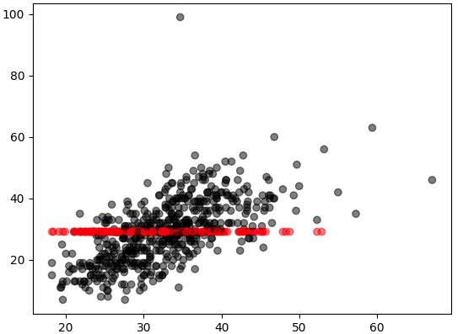
Synthetic data

Slide 13
Purpose

Slide 15

ONLINE REFERENCES
https://www.jaredknowles.com/journal/2013/11/25/getting-started-with-mixed-effect-models-in-r
https://www.jaredknowles.com/journal/2013/11/25/getting-started-with-mixed-effect-models-in-r
https://github.com/becarioprecario/SAERTutorial/blob/master/SAE04.pdf
https://www.r-bloggers.com/sampling-weights-and-multilevel-modeling-in-r/
https://www.r-bloggers.com/small-area-estimation-101/
https://www.r-bloggers.com/small-area-estimation-101-old-materials-posted/
https://stat.ethz.ch/education/semesters/ss2012/ams/paper/missForest_1.2.pdf
https://journal.r-project.org/archive/2015/RJ-2015-007/RJ-2015-007.pdf
https://ww2.amstat.org/sections/srms/Proceedings/y2007/Files/JSM2007-000789.pdf

Slide 16
Book References

Slide 17
Further Reading/Related work
https://www.sciencedirect.com/science/article/pii/S0198971516301338#f0010
http://www.nyu.edu/classes/jackson/design.of.social.research/Readings/Johnson%20-%20Introduction%20to%20survey%20weights%20%28PRI%20version%29.pdf
https://www.sciencedirect.com/science/article/pii/S0167947312003222
https://www.sciencedirect.com/science/article/pii/S016794731500170X#s000065

Slide 18
Appendix
https://docs.google.com/spreadsheets/d/1Rjwmx6DjnWOf_lD5Gm3MlFFpLH1umO_ZJyqOecAHwY4/edit#gid=1100499396

